Slide 1
Practical Malware Analysis
Chapter 4: A Crash Course in x86 Disassembly
2026.01.14
Presenter : Yena Cho

Slide 2
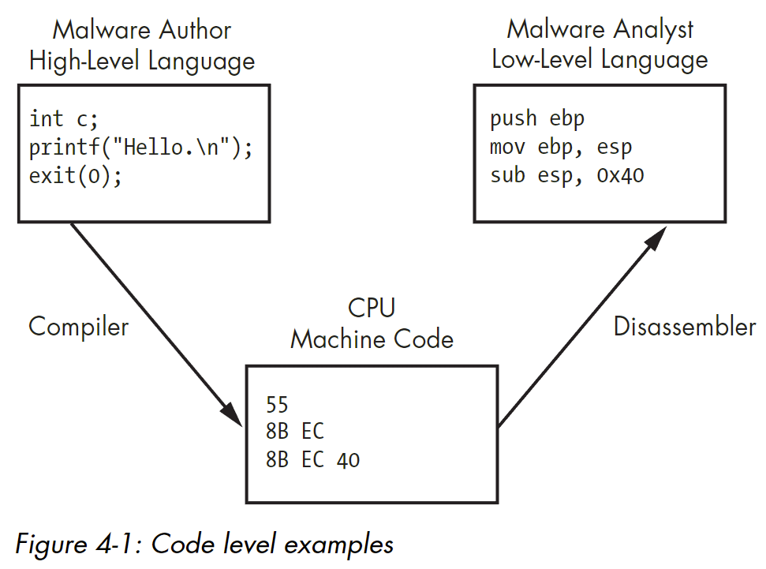
Why Do We Need to Understand Disassembly?
Static analysis can infer what a program might do, but it cannot determine whether the code actually executes.
Dynamic analysis shows only the behaviors that appear during execution.
Therefore, to understand the true intent of malware, we must disassemble CPU machine code into human-readable low-level instructions.

Slide 3
Level of Abstraction
Hardware
Physical level made of electrical logic circuits (e.g., AND, OR, XOR).
Microcode
Translate machine instructions into hardware action.
Machine code
Bytecode executed by the CPU.
Low-level language (Assembly)
human-readable version of a computer architecture’s instruction set.
High-level languages (C, C++..)
Most computer program language.
Interpreted languages (C#, Java..)
Translated into bytecode and executed within an interpreter that converts it into machine code.

Slide 4
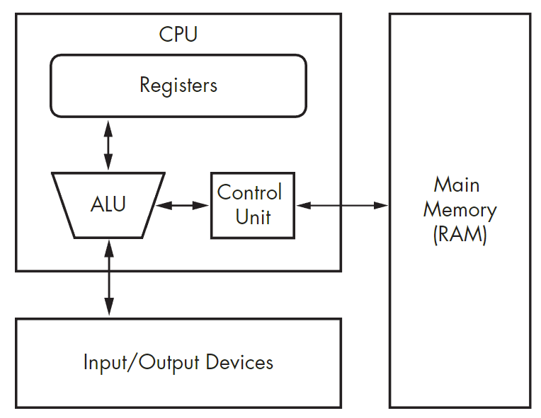
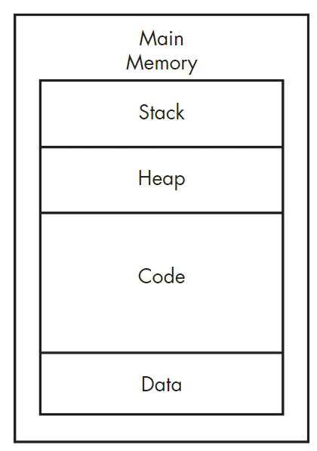
x86 Architecture

Slide 5
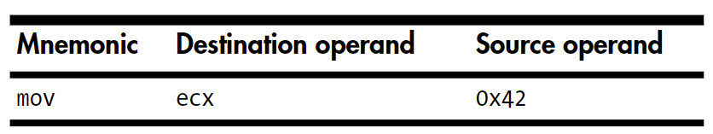
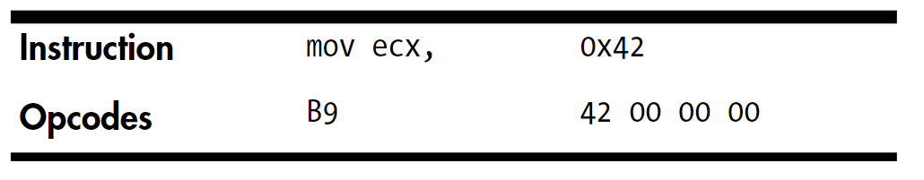
Instructions
x86 Assembly
Machine code
Mnemonic: what action to perform
Operand: values or locations
Opcode: Operation code
mov
lea
add
sub
inc
dec
mul
div
nop
…
ISA (Instruction Set Architecture)
0x42
Little-endian: 42 00 00 00
Big-endian: 00 00 00 42
Immediate operand: 0x42
Register operand: ecx
Memory address operand: [0x42]

Slide 6
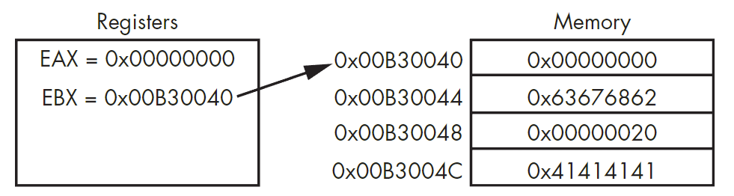
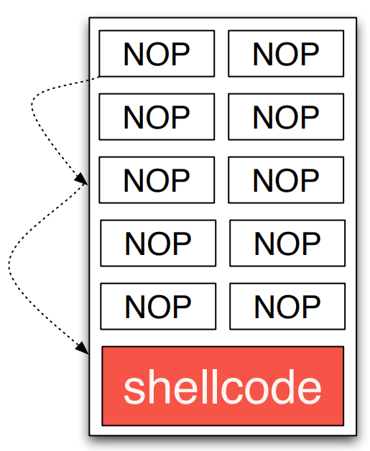
Key Instructions
mov vs. lea
mov(move): move data into destination.
lea(load effective address): put memory address into destination.
mov eax, [ebx] → eax = 0x00000000
lea eax, [ebx] → eax = 0x00B30040
mov eax, [ebx+8] → eax = 0x00000020
lea eax, [ebx+8] → eax = 0x00B30048
nop (no operation)
Just moves to the next instruction.
Provides execution padding (NOP sled) to reach the shellcode even when the exact address is unknown.
NOP sled

Slide 7
Registers - small amount of data storage in CPU
General Registers: Flexible, but some have special roles defined by instructions.
Segment Registers: Store base addresses for memory segments.
Status Flags: Displays the status of arithmetic operation results.
Instruction Pointers: Keep track of the next instruction to execute (EIP)
EAX (Accumulator) | Function return value, Arithmetic operation
EBX (Base Register) | Memory address
ECX (Count Register) | Loop counter
EDX (Data Register) | EAX extension (mul/div)
 | When Flag = 1
ZF (Zero Flag) | Result == 0
CF (Carry Flag) | Unsigned overflow
SF (Sign Flag) | Result < 0
TF (Trap Flag) | Execute only one instruction at a time

Slide 8
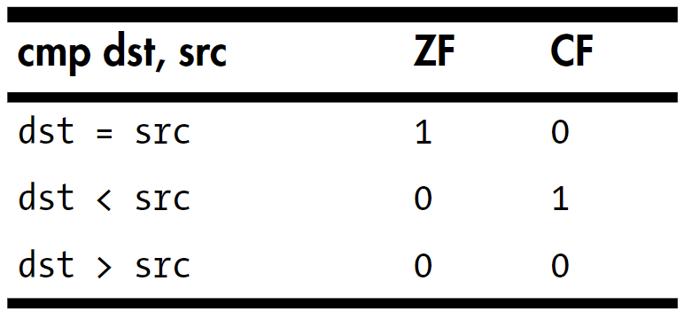
Conditionals & Branching – changing execution flow based on flag values
Conditionals: Comparison instruction without modifying the operands.
The test performs an AND operation to set CPU flags (especially ZF). test eax, eax : If eax & eax == 0, then ZF = 1.
The cmp performs a subtraction to set flags (such as ZF and CF).
cmp dst, src = dst - src
Branching: Change execution flow by jumping to a different instruction address based on a condition.
Unconditional Jump
Conditional Jump (jz, jnz …)
mov eax, 0
test eax, eax
jz 0x12345678
eax = 0
eax & eax == 0 → ZF = 1
Since ZF = 1, jump to 0x12345678 !

Slide 9
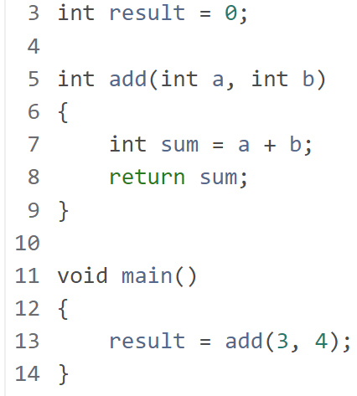
Stack - data structure in RAM
Stack stores function-related data and is allocated on function calls and freed when return.
Last in, First out (LIFO) structure.
Top-down format in memory.
Stack Pointer: 0xFFF8
Base Pointer: 0xFFFF
0xFFF7
0xFFF8
0xFFF9
0xFFFA
0xFFFB
0xFFFC
0xFFFD
0xFFFE
0xFFFF
Main’s Stack Frame

Slide 10
Stack Frame
Stack Pointer: 0xFFF8
Base Pointer: 0xFFFF
0x0004 | mov edi, 3
0x0009 | mov esi, 4
0x000E | call add
0x0013 | mov [0x1234], eax
Store 3 in edi register
Store 4 in esi register
0x0020 | push rbp
0x0021 | mov rbp, rsp
0x0024 | sub rsp, 4
0x0028 | mov eax, edi
0x002A | add eax, esi
0x002C | mov [rbp-4], eax
0x002F | mov eax, [rbp-4]
0x0032 | add rsp, 4
0x0036 | pop rbp
0x0037 | ret
0xFFF7
0xFFF8
0xFFF9
0xFFFA
0xFFFB
0xFFFC
0xFFFD
0xFFFE
0xFFFF

Slide 11
Stack Frame
Stack Pointer: 0xFFF7
Base Pointer: 0xFFFF
0x0004 | mov edi, 3
0x0009 | mov esi, 4
0x000E | call add
0x0013 | mov [0x1234], eax
Store return val (eax) in result (0x1234)
0x0020 | push rbp
0x0021 | mov rbp, rsp
0x0024 | sub rsp, 4
0x0028 | mov eax, edi
0x002A | add eax, esi
0x002C | mov [rbp-4], eax
0x002F | mov eax, [rbp-4]
0x0032 | add rsp, 4
0x0036 | pop rbp
0x0037 | ret
0xFFF7
0xFFF8
0xFFF9
0xFFFA
0xFFFB
0xFFFC
0xFFFD
0xFFFE
0xFFFF
0x0013

Slide 12
Stack Frame
Stack Pointer: 0xFFF6
Base Pointer: 0xFFF6
0x0004 | mov edi, 3
0x0009 | mov esi, 4
0x000E | call add
0x0013 | mov [0x1234], eax
Main’s base pointer
0x0020 | push rbp
0x0021 | mov rbp, rsp
0x0024 | sub rsp, 4
0x0028 | mov eax, edi
0x002A | add eax, esi
0x002C | mov [rbp-4], eax
0x002F | mov eax, [rbp-4]
0x0032 | add rsp, 4
0x0036 | pop rbp
0x0037 | ret
0xFFF6
0xFFF7
0xFFF8
0xFFF9
0xFFFA
0xFFFB
0xFFFC
0xFFFD
0xFFFE
0xFFFF
0xFFFF
0x0013

Slide 13
Stack Frame
Stack Pointer: 0xFFF2
Base Pointer: 0xFFF6
0x0004 | mov edi, 3
0x0009 | mov esi, 4
0x000E | call add
0x0013 | mov [0x1234], eax
0xFFF2
0xFFF3
0xFFF4
0xFFF5
0xFFF6
0xFFF7
0xFFF8
0xFFF9
0xFFFA
0xFFFB
0xFFFC
0xFFFD
0xFFFE
0xFFFF
Add’s Frame
0x0020 | push rbp
0x0021 | mov rbp, rsp
0x0024 | sub rsp, 4
0x0028 | mov eax, edi
0x002A | add eax, esi
0x002C | mov [rbp-4], eax
0x002F | mov eax, [rbp-4]
0x0032 | add rsp, 4
0x0036 | pop rbp
0x0037 | ret
Allocate 4 bytes
Main’s Frame

Slide 14
Stack Frame
Stack Pointer: 0xFFF2
Base Pointer: 0xFFF6
0x0004 | mov edi, 3
0x0009 | mov esi, 4
0x000E | call add
0x0013 | mov [0x1234], eax
0xFFF2
0xFFF3
0xFFF4
0xFFF5
0xFFF6
0xFFF7
0xFFF8
0xFFF9
0xFFFA
0xFFFB
0xFFFC
0xFFFD
0xFFFE
0xFFFF
0x00
0x00
0x00
Add’s Frame
0x07
0x0020 | push rbp
0x0021 | mov rbp, rsp
0x0024 | sub rsp, 4
0x0028 | mov eax, edi
0x002A | add eax, esi
0x002C | mov [rbp-4], eax
0x002F | mov eax, [rbp-4]
0x0032 | add rsp, 4
0x0036 | pop rbp
0x0037 | ret
Sum operation
: 3 + 4 = 7
Main’s Frame

Slide 15
Stack Frame
Stack Pointer: 0xFFF6
Base Pointer: 0xFFF6
0x0004 | mov edi, 3
0x0009 | mov esi, 4
0x000E | call add
0x0013 | mov [0x1234], eax
0x0020 | push rbp
0x0021 | mov rbp, rsp
0x0024 | sub rsp, 4
0x0028 | mov eax, edi
0x002A | add eax, esi
0x002C | mov [rbp-4], eax
0x002F | mov eax, [rbp-4]
0x0032 | add rsp, 4
0x0036 | pop rbp
0x0037 | ret
0xFFF6
0xFFF7
0xFFF8
0xFFF9
0xFFFA
0xFFFB
0xFFFC
0xFFFD
0xFFFE
0xFFFF
Main’s Frame
Deallocate stack frame

Slide 16
Stack Frame
Stack Pointer: 0xFFF6
Base Pointer: 0xFFFF
0x0004 | mov edi, 3
0x0009 | mov esi, 4
0x000E | call add
0x0013 | mov [0x1234], eax
0x0020 | push rbp
0x0021 | mov rbp, rsp
0x0024 | sub rsp, 4
0x0028 | mov eax, edi
0x002A | add eax, esi
0x002C | mov [rbp-4], eax
0x002F | mov eax, [rbp-4]
0x0032 | add rsp, 4
0x0036 | pop rbp
0x0037 | ret
0xFFF6
0xFFF7
0xFFF8
0xFFF9
0xFFFA
0xFFFB
0xFFFC
0xFFFD
0xFFFE
0xFFFF
0xFFFF
Main’s Frame

Slide 17
Stack Frame
Stack Pointer: 0xFFF7
Base Pointer: 0xFFFF
0x0004 | mov edi, 3
0x0009 | mov esi, 4
0x000E | call add
0x0013 | mov [0x1234], eax
Jump
0x0020 | push rbp
0x0021 | mov rbp, rsp
0x0024 | sub rsp, 4
0x0028 | mov eax, edi
0x002A | add eax, esi
0x002C | mov [rbp-4], eax
0x002F | mov eax, [rbp-4]
0x0032 | add rsp, 4
0x0036 | pop rbp
0x0037 | ret
0xFFF7
0xFFF8
0xFFF9
0xFFFA
0xFFFB
0xFFFC
0xFFFD
0xFFFE
0xFFFF
0x0013
Main’s Frame

Slide 18
Conclusion
How x86 executes a program in assembly
x86 architecture
Instructions
mov, lea, nop, conditionals, branching..
Registers
Fast storage for values, addresses, counters, and return values.
Stack
How assembly functions work using stack.
Shows how functions are executed by storing data in the stack and running instructions step by step.

